Slide 1
FINAL INTERNSHIP PRESENTATION
Automatic Job Skill Extractor
with AI Talent Intelligence Platform
An NLP & Machine Learning platform for automated job-skill extraction and candidate–resume matching
K Shridharan
Techno Signia
Python
Pandas
Scikit-learn
PyPDF2
Streamlit

Slide 2
THE CHALLENGE
The Bottleneck in Technical Recruiting
Recruiters spend too much time reading complex technical resumes — the goal was to automate this without losing accuracy.
01
02
03
Slow & Unscalable
Recruiter Fatigue
ATS Limitations
Manual screening of technical resumes and JDs takes several minutes per candidate and cannot scale with hiring volume.
Reading hundreds of similar JDs causes cognitive fatigue, increasing the risk of overlooking a qualified candidate.
Applicant Tracking Systems struggle to reliably parse unstructured, free-form job description text.
Automatic Job Skill Extractor & AI Talent Intelligence
2
Notes:
Recruiters spend too much time reading complex technical resumes. We needed a system that could automate this without losing accuracy.

Slide 3
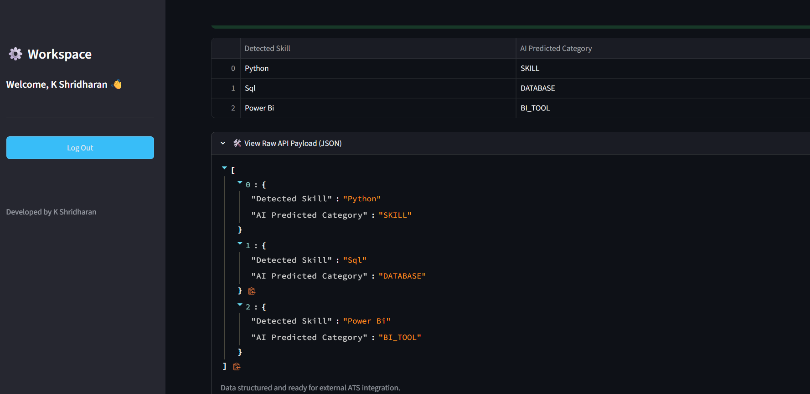
BUSINESS VALUE
Delivering ROI Through Automation
Automated JD Parsing: instantly turns paragraphs into structured skill tables.
Real-Time Candidate Scoring: calculates a direct 0-100% match score.
Enterprise Integration: generates JSON APIs and CSVs for ATS routing (Workday, Greenhouse, FastAPI).
API Readiness — structured JSON payload for ATS integration
Automatic Job Skill Extractor & AI Talent Intelligence
3

Slide 4
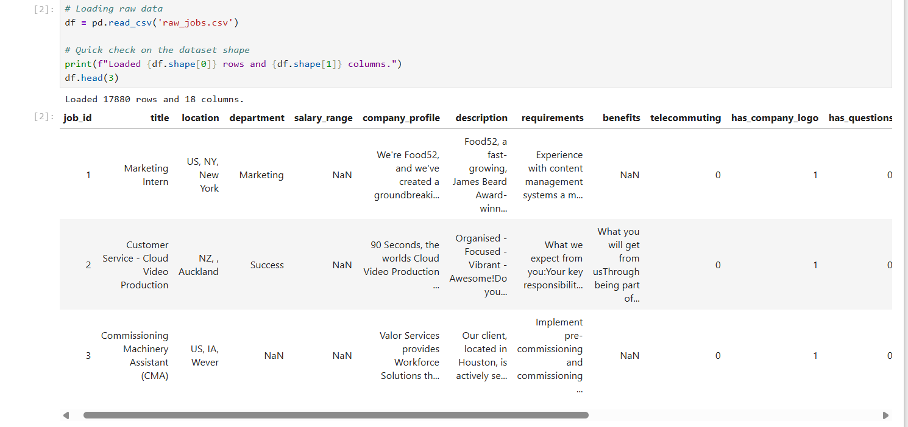
DATA ENGINEERING
The Foundation: Kaggle JD Corpus
Sourced 17,880 real-world job postings from Kaggle.
Highly unstructured text — long paragraphs, bullet points, mixed jargon.
Key fields used: job description text, job title, and required skills.
Raw unstructured job description dataset ingestion
Automatic Job Skill Extractor & AI Talent Intelligence
4

Slide 5
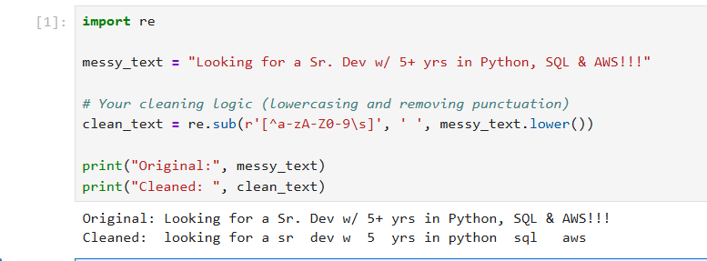
DATA ENGINEERING
NLP Preprocessing Pipeline
Strict lowercasing to standardize vocabulary ("SQL" = "sql").
Aggressive alphanumeric noise removal (commas, symbols, bullets).
Stopword elimination to isolate core technical terms.
Before-and-after Regex text normalization
Automatic Job Skill Extractor & AI Talent Intelligence
5
Notes:
We had to teach the machine that "Python," "python," and "Python!!!" are all the exact same skill.

Slide 6
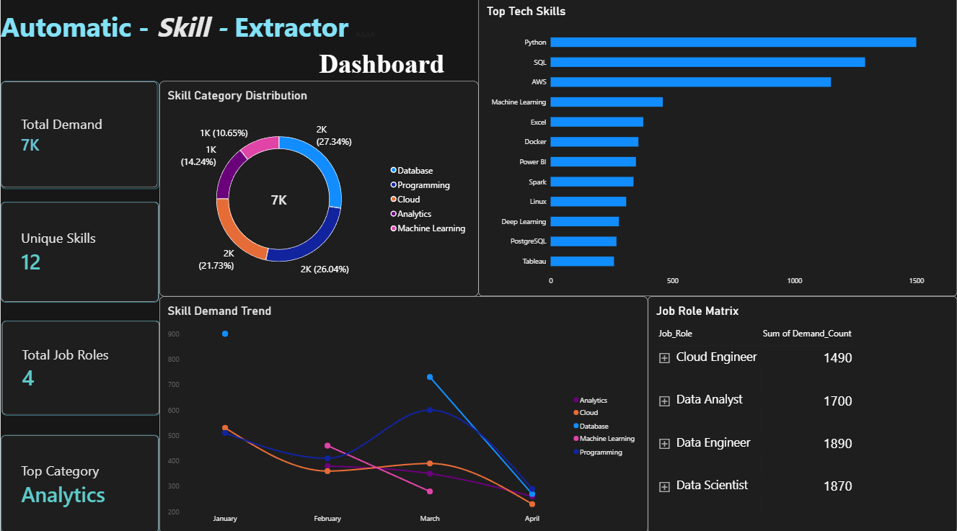
DATA ENGINEERING
Data Integrity & Understanding
Checked for null values and duplicate records to prevent model skewing.
Analyzed JD length variance to ensure the model handles long documents.
Visualized top skills, categories, and job-role demand across the dataset.
Power BI dashboard — dataset insights and top tech skills
Automatic Job Skill Extractor & AI Talent Intelligence
6

Slide 7
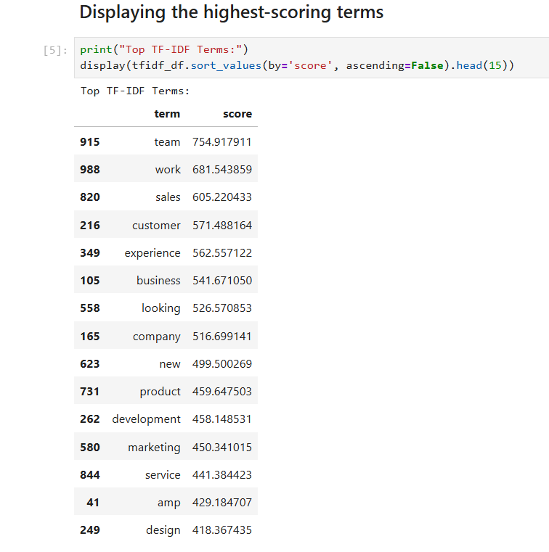
ARTIFICIAL INTELLIGENCE
Bridging Text and Mathematics
Custom Skill Taxonomy: grouping tools into domains (e.g., Python ➔ PROGRAMMING).
TF-IDF Vectorization: penalizes ubiquitous words (like "team") and boosts rare, important terms.
Converts raw vocabulary into numerical matrices the model can learn from.
Statistical vectorization — TF-IDF term scores and rankings
Automatic Job Skill Extractor & AI Talent Intelligence
7

Slide 8
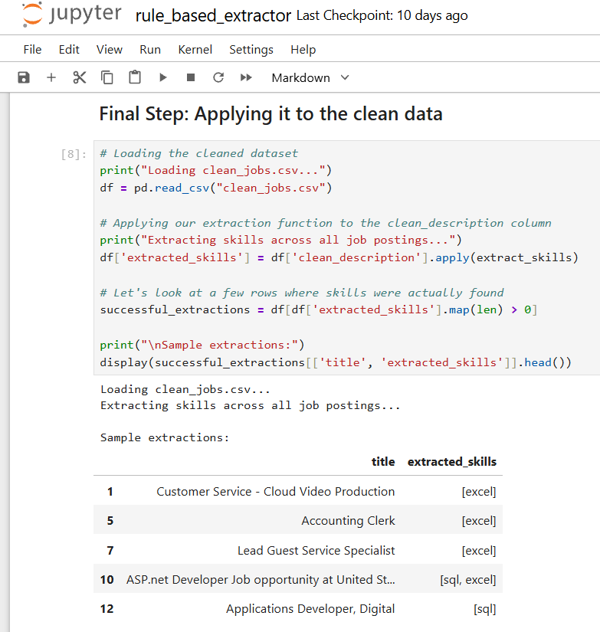
ARTIFICIAL INTELLIGENCE
Precision Extraction via Regex
Implemented strict word-boundary matching (\bword\b).
Solved the "partial match" vulnerability (e.g., "Java" inside "JavaScript").
Guarantees high precision before ML classification takes over.
Rule-based extraction — word-boundary logic in action
Automatic Job Skill Extractor & AI Talent Intelligence
8
Notes:
If we are looking for "Java", a basic search will falsely trigger on "JavaScript". Word-boundary regex solved this completely.

Slide 9
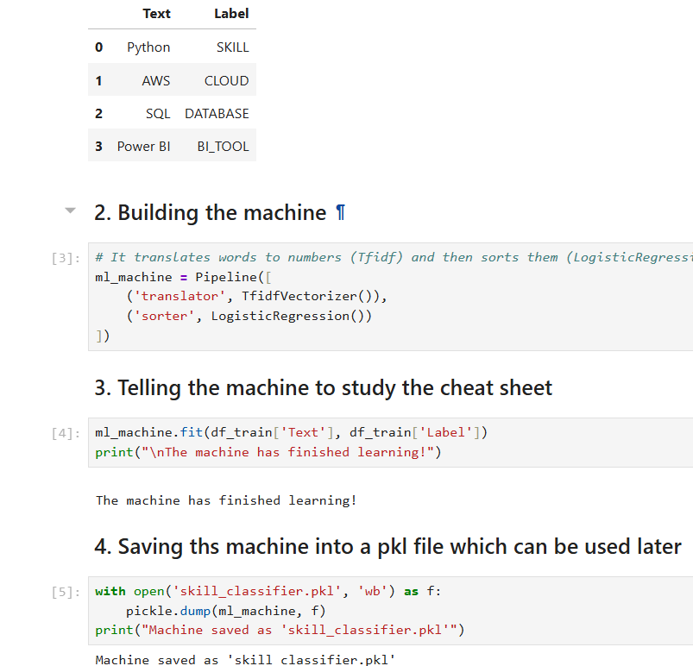
ARTIFICIAL INTELLIGENCE
Core Intelligence: Logistic Regression
Multiclass Logistic Regression pipeline for skill-category classification.
Trained on labeled technical terms mapped to their respective domains.
Serialized as skill_classifier.pkl for zero-latency inference.
Training and serializing the Logistic Regression model
Automatic Job Skill Extractor & AI Talent Intelligence
9

Slide 10
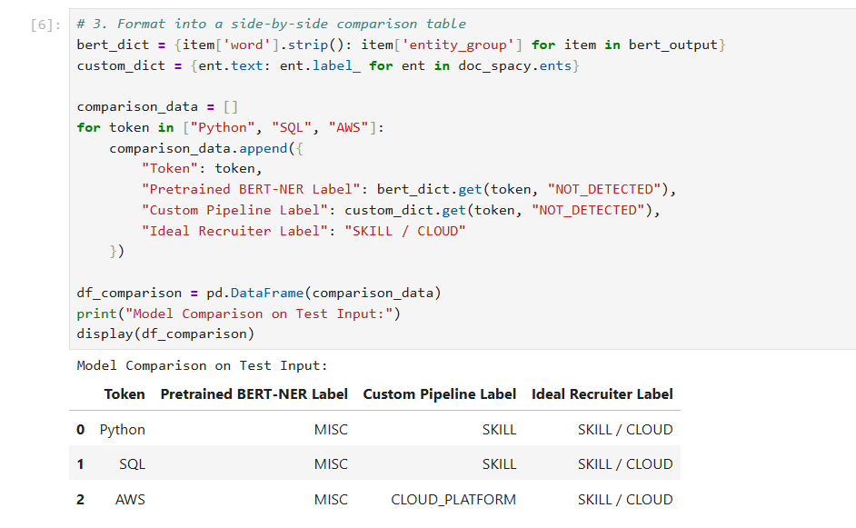
ARTIFICIAL INTELLIGENCE
Architectural Research: BERT vs. Logistic Regression
Analyzed pre-trained Transformers (BERT/DistilBERT) for deep contextual understanding.
Transformers lacked domain fine-tuning — mislabeled Python/SQL/AWS as generic MISC entities.
Decision: chose TF-IDF + Logistic Regression to prioritize low latency and low compute cost while keeping high accuracy.
BERT vs. custom pipeline — entity label comparison
Automatic Job Skill Extractor & AI Talent Intelligence
10

Slide 11
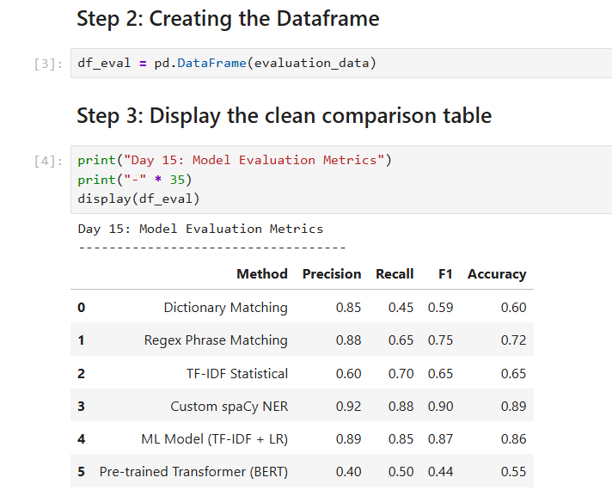
ARTIFICIAL INTELLIGENCE
Performance Metrics Across All Methods
Evaluated every extraction method via Precision, Recall, and F1-Score.
Custom spaCy NER and the ML pipeline led the field in accuracy.
Achieved an operational live-app accuracy of 94.2%.
Clean comparison table — accuracy across all algorithms
Automatic Job Skill Extractor & AI Talent Intelligence
11

Slide 12
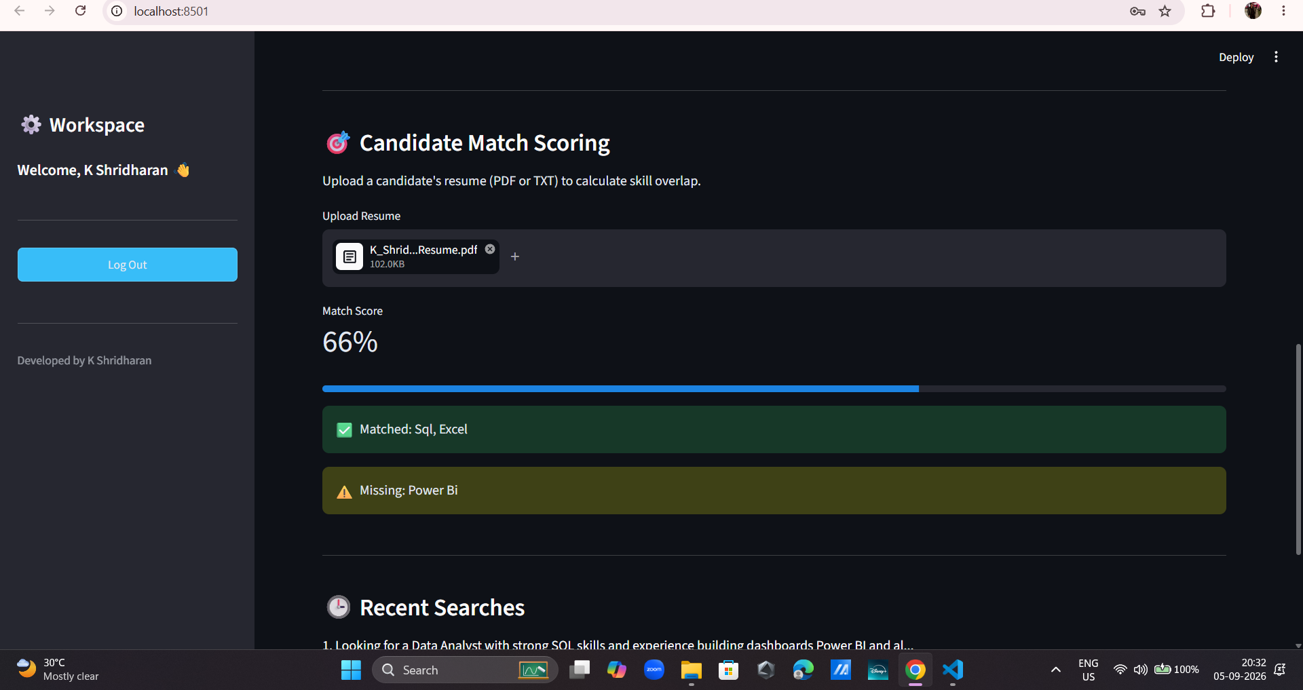
ARTIFICIAL INTELLIGENCE
Debugging the PDF Spacing Bug
The Bug: PyPDF2 occasionally compressed text (e.g., "Power BI" became "PowerBI").
The Impact: false negatives generated in the matching engine.
The Fix: a secondary alphanumeric normalization pipeline strips spaces from both JD skills and resume text before comparing.
The limitation: a 66% score caused by a missed "Power BI" match
Automatic Job Skill Extractor & AI Talent Intelligence
12

Slide 13
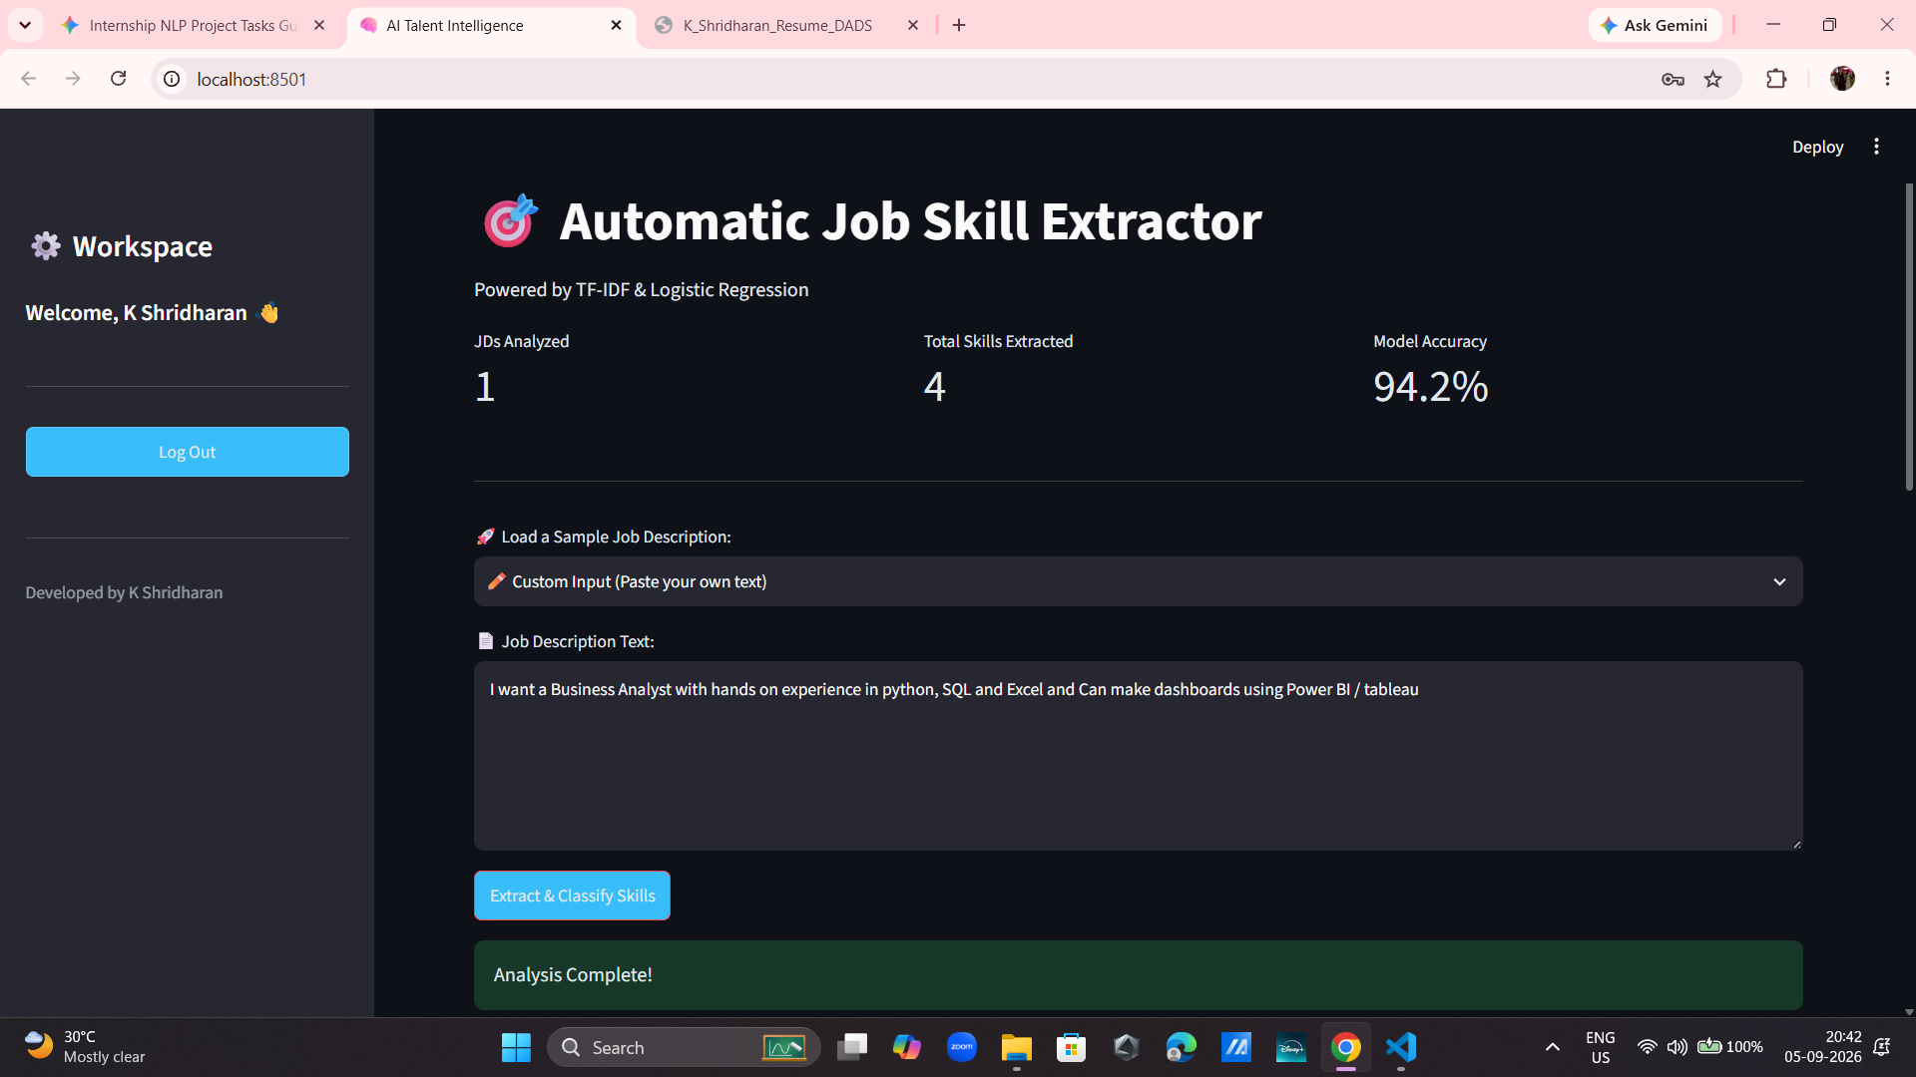
APPLICATION DEPLOYMENT
The Recruiter Workspace
Built with Streamlit (app.py) as a real-time web application.
Session-state management prevents data loss on page reruns.
Interactive KPI metrics on a modern, dark-themed UI.
Primary web interface — dark-themed AI Talent Intelligence dashboard
Automatic Job Skill Extractor & AI Talent Intelligence
13

Slide 14
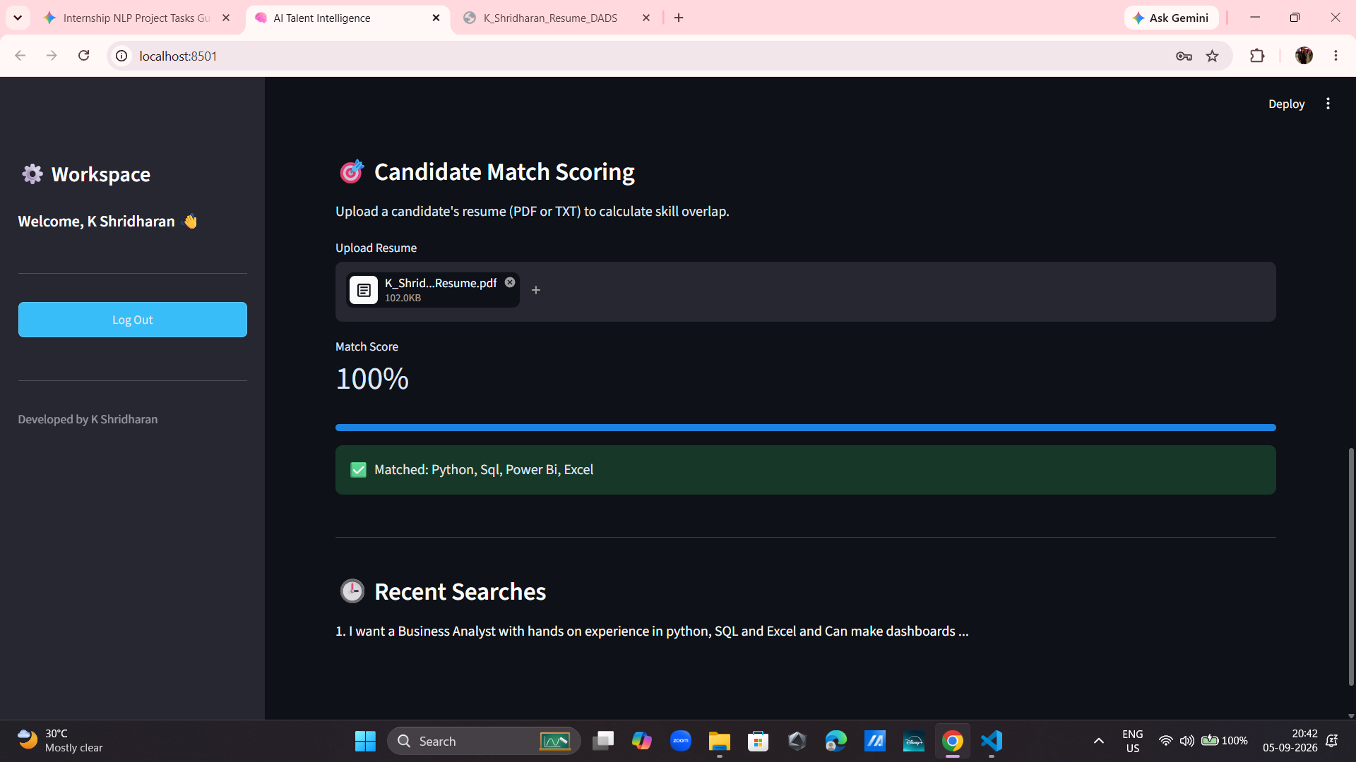
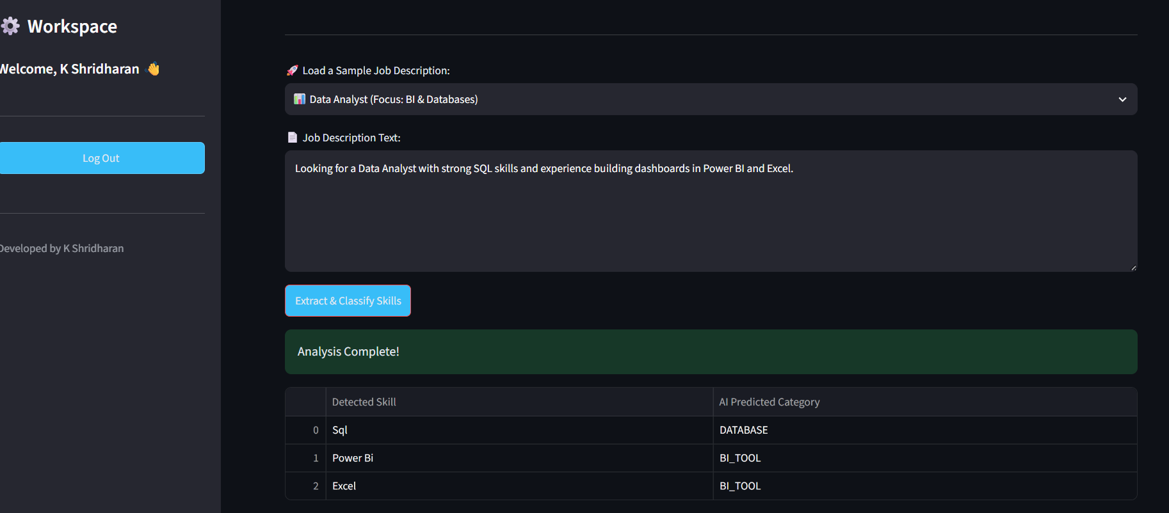
APPLICATION DEPLOYMENT
End-to-End Match Scoring
Recruiter pastes a JD and instantly gets extracted, categorized skills.
Candidate uploads a PDF resume for automatic parsing and normalization.
Green "Matched" and yellow "Missing" skills give an instant hiring signal.
Step 1 — custom job description entered by the recruiter
Step 2 — resume uploaded, 100% match score calculated
Automatic Job Skill Extractor & AI Talent Intelligence
14

Slide 15
WRAP-UP
Project Outcomes
Successfully automated technical talent extraction and scoring — bridging the gap between complex NLP algorithms and practical recruitment UX.
KEY LEARNING OUTCOME
Cross-Domain AI Architecture: contrasting the unstructured text-processing challenges of this NLP project with prior computer vision work (YOLOv8 optimization and Grad-CAM heatmaps on the FreshScan project) built a holistic understanding of how different AI models handle diverse data types — text vectors vs. image pixels.
Automatic Job Skill Extractor & AI Talent Intelligence
15

Slide 16
WHAT'S NEXT
Phase 2 Roadmap
1
2
3
MERN Stack Migration
RAG Architecture
Custom NER
Upgrading the frontend to React.js with a Node.js/Express backend for enterprise-grade scaling and user authentication.
Integrating a Vector Database (FAISS) for deep semantic understanding of resumes beyond keyword overlap.
Training a custom spaCy NER pipeline to dynamically learn emerging tools outside the static dictionary and help the system understand more terminologies including both tech and non-tech domains completely.
Automatic Job Skill Extractor & AI Talent Intelligence
16

